Slide 1
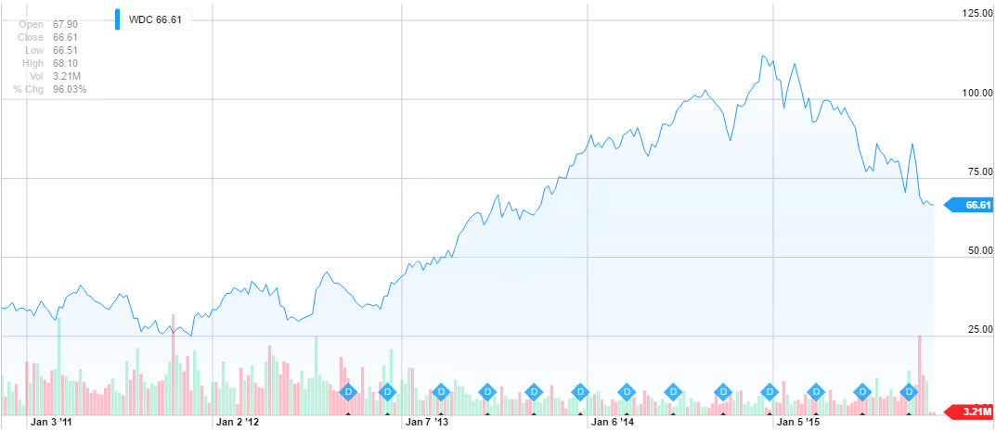
Western Digital (WDC)
Arman Hastings
November 12th, 2015 Technology

Slide 2
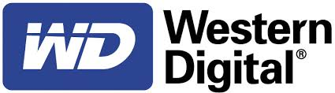
Business Overview
Founded in 1970 by Alvin B. Phillips.
Originally known as General Digital.
Rapidly became a specialty semiconductor maker with start-up capital given by investors and industrial giant Emerson Electric Company.
1971: General Digital changed their name to Western Digital.
1975: Western Digital was the largest independent calculator chip maker in the world.
1976: With the Oil crisis of the mid-1970s, and with bankruptcy of WDC’s Biggest customer Western Digital filed for (ch.11) bankruptcy.

Slide 3

Business Overview
1980s: Entered the data storage industry by making hard disk drive controllers.
1983: Won the contract to provide IBM with controllers for their products.
1986: Many products they made created a basis for the data industry to even be used by competitors (Ex. Seagate with their MPI Divison).
1988: Biggest change in WDC’s history; Acquiring Tandon and selling their first product under their own name.
1998: Western Digital recruited the help of IBM which worked & later broke ties.
2003: Acquired assets of bank-rupt one time hard drive developers Read-Rite Corp.
2007: Acquired magnetic media marker Komag.
2010: Acquired Magnetic glass media sputtering operations of HOYA corp & HOYA.
2012: Acquired Hitachi Global Storage Technologies.
2015: Acquired SanDisk for 19B

Slide 4
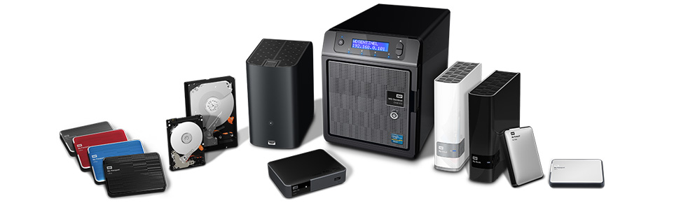
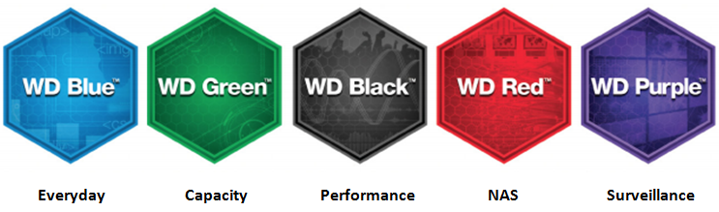
Business Channels
Product Focus Categories:
Everyday
Capacity
Performance
NAS
Surveillance
Products Lines:
External Storage
Personal Cloud products
Home Entertainment
Internal Storage
Software

Slide 5

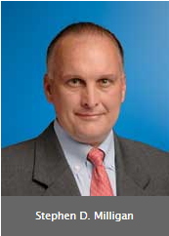


Corporate Governance
Steve Milligan
Chief Executive Officer
VP of Western Digital in 2002
Re-joined Western Digital as president in March 2012.
Appointed chief executive officer 2013
Was president and chief of Hitachi prior of the acquisition.
Olivier C Leonetti
Vice president appointed in 2014
Prior Leonetti was Vice President of global commercial organization at Amgen.
ISS Governance Score 3:
Audit: 1; Board: 6;
Shareholder Rights: 3; Compensation:6

Slide 6
Competitive Positioning
Competitiveness:
Product performance and reliability
Success with major Industry developments
Creating a solid and very solid main product line
Success in developing products features/applications.
Acquisitions.
Simple and very focused marketing on product lines and product focus
Number of nature and competitors in a given market

Slide 7
Competitive Strategy
Growth
Western Digital believe in three main strategies to allow them to grow and increase their market share, which are:
Expansion in Emerging Markets
Western Digital looks East to countries like China, India, and select part of Africa for new growth.
Acquisitions to Increase Margins
As seen with SanDisk and Hitachi
Focus on Hard Disk Drives
Western digital believes in mastering the traditional hard drives and uses them for the backbone of their profit lines.

Slide 8

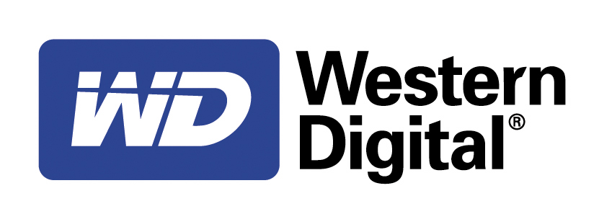
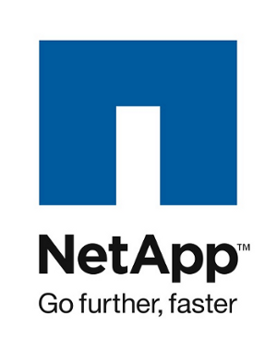
Competitive Positioning
Seagate Technology (STX)
Offers hard disk drives and SSDs
Data-recovery services
EMC Corp. (EMC)
offers data storage, information security, virtualization, analytics, cloud computing and other products
Largest provider of data storage systems
NetApp (NTAP)
Offers data storage, cloud computing
Work primairly with data management more than data storage.

Slide 9
Current Events
Western Digital Announces Joint Venture with China-based technology company Unisplendour Corp. Limited. - 11/9/2015
Selling 15% of their shares allowing for one them to have one member on Western Digitals Board
Western Digital Announces Financial Results For The First Quarter Fiscal 2016 - 10/26/2015
(Presented in the excel sheet)
Western Digital Announces Acquisition Of SanDisk for 19 Billion - 10/21/2015
SanDisk Shares jump on late-stage acquisition talk report - 10/19/2015

Slide 10
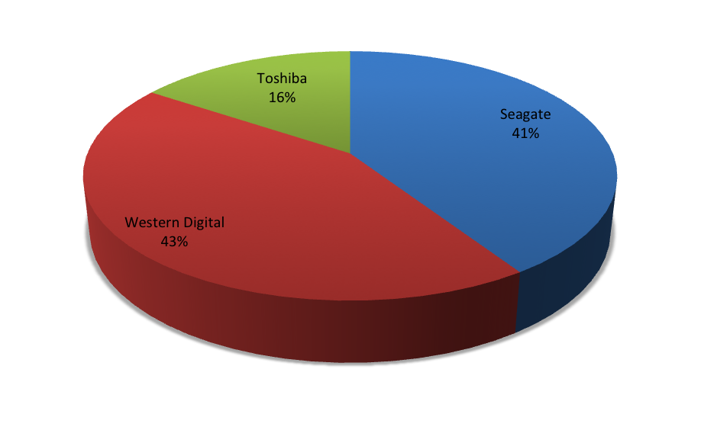
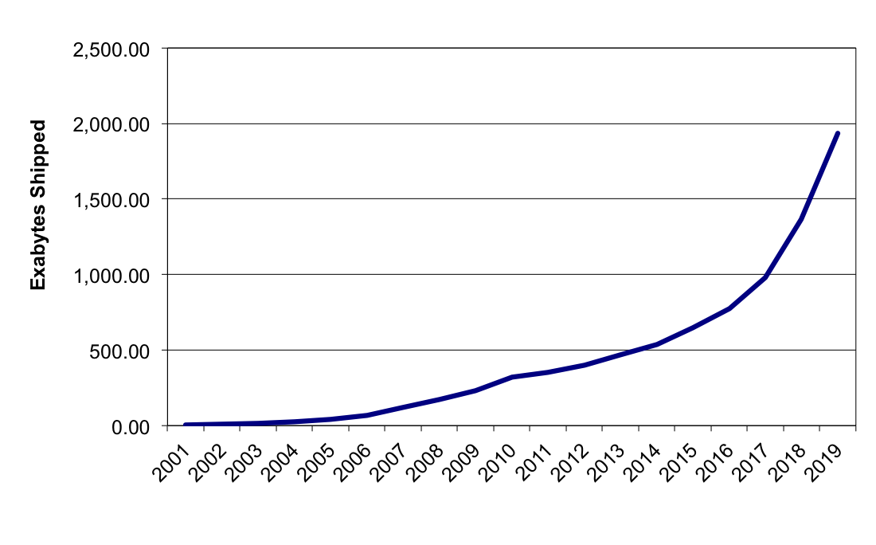
Sources of Revenue
HDD Market Share
Amount of Exabytes of memory expected to be purchased and shipped

Slide 11
Financial Performance

Slide 12
Financial Positioning
Slight decrease in Net Sales for 2014 and 2015.
Net sales decreased from $15,152 in 2013 to $15,130M and to $14,572M in 2015
Steady budget in Research and Development
Trust in Hard Disk Drives
Development costs are predictable with focused product line
Net Cash from Operating Expenses
$530M (2012) to $1,864M (2013)
Payment to SanDisk and their shareholders
Recent Purchase of SanDisk may have an affect for their 2016 financial positioning

Slide 13
Valuation: Relative & Historical
STX | SNDK | EMC | MU | NTAP
30% | 25% | 20% | 15% | 15%
Relative
Value Per Share | $100.91
Current Price | $63.58
Undervalued | 58.72%
Weight | 33%
Historical
Discounted Value per Share | $75.66
Current Price | $63.58
Overvalued | 14.61%
Weight | 35%

Slide 14
Valuation: DCF
3 Stages of growth:
Stage 1: Increase in revenue due to new acquisitions
Stage 2: Steady increase revenue due to increase in expected market share and expected decrease popularity in Hard Disk Drives.
Stage 3: Steady increase on revenue as competitive forces will decrease creating the possibility of revenue increase.
Assumptions were based on DCF Growth Rates and previous performance
Discounted Value | $94.85
Current Price | $63.58
Undervalued | 49.17%
Weight | 33%

Slide 15
Final Valuation
 | Valuation | Weights
DCF | $94.85 | 33%
Relatives | $100.91 | 33%
Historical | $69.61 | 33%
Current Price | $63.58
Intrinsic Value | $87.57
Margin of Safety | 37.73%

Slide 16

Recommendation
Recommend a BUY:
One of the largest hard disk drive manufacturers
Global leader in quality hard disk drive products
Strive for growth with acquisitions and interest in developing markets

Slide 17
Questions?

